Slide 1
Handwriting Analysis
Using convolutional neural networks

Slide 2
AGENDA
Objective
CSAFE
MNIST
TrOCR
CNN
Result

Slide 3
objective
To develop a Convolutional Neural Network (CNN) capable of determining whether an image of handwriting was produced by a left- or right-handed person. The analysis will include Microsoft’s TrOCR for feature extraction and CNN to classify handwriting into left-handedness or right-handedness.

Slide 4
CSAFE Handwriting database
This work was partially funded by the Center for Statistics and Applications in Forensic Evidence (CSAFE) through Cooperative Agreement #70NANB15H176 between NIST and Iowa State University, which includes activities carried out at Carnegie Mellon University, University of California Irvine, and University of Virginia.
CSAFE Handwriting Database (figshare.com)

Slide 5
MNIST
preprocessing, augmentation, normalization

Slide 6
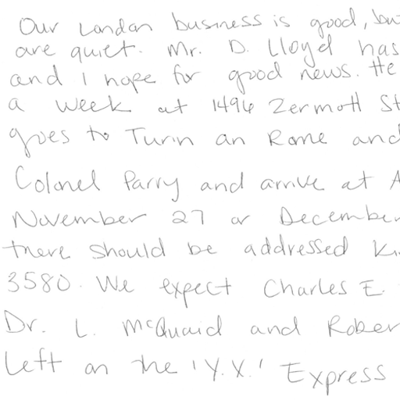
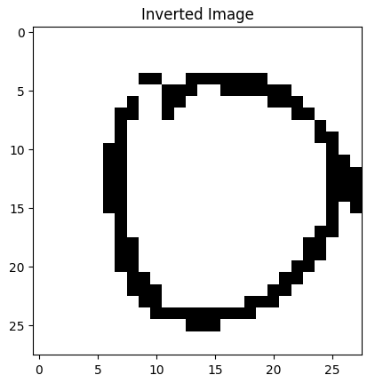
Preprocessing

Slide 7
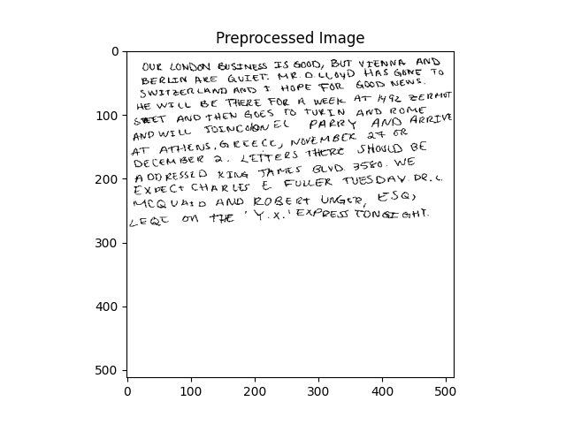
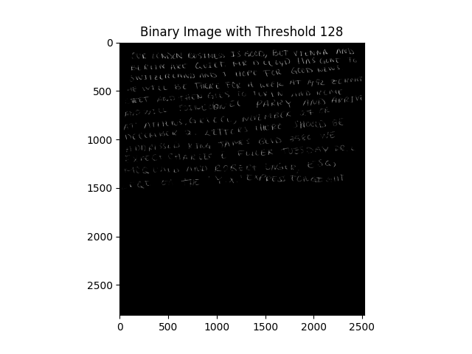
augmentation

Slide 8
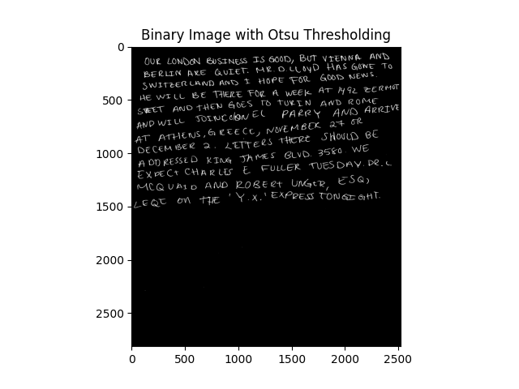
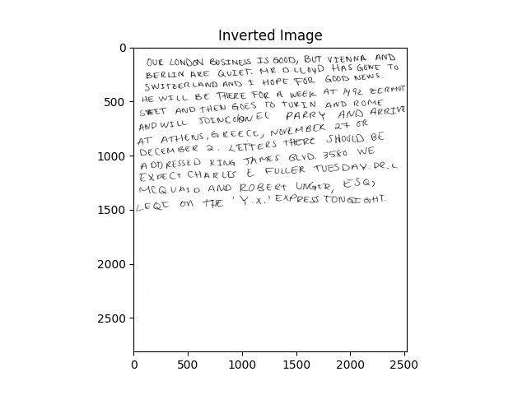
augmentation

Slide 9
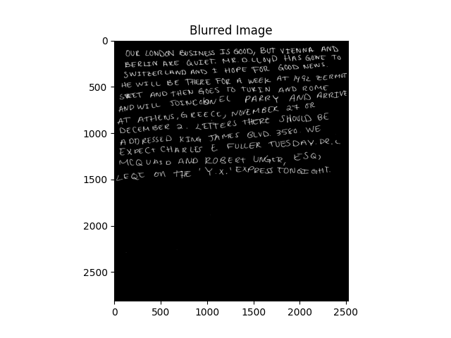

AUGMENTATION

Slide 10
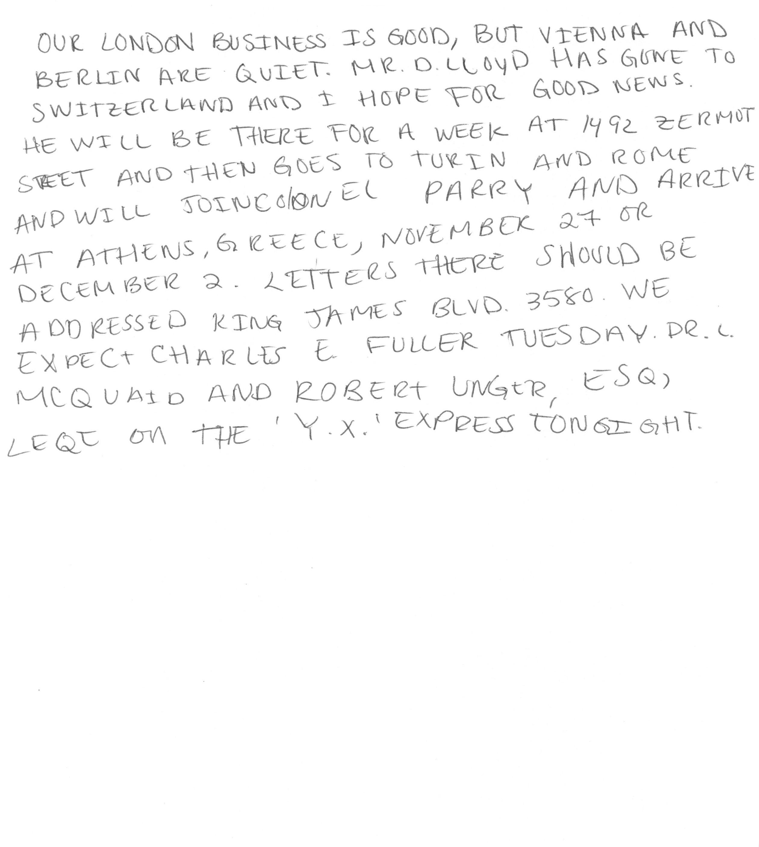
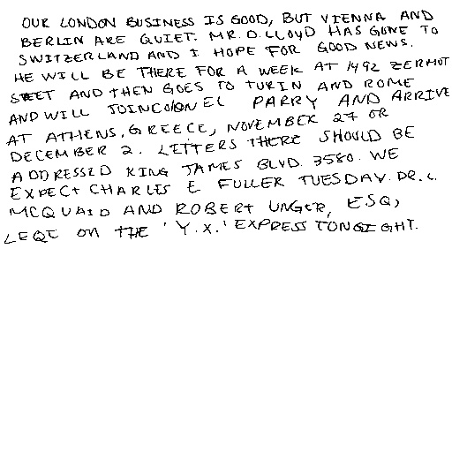
Normalization

Slide 11
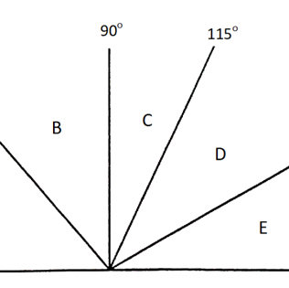
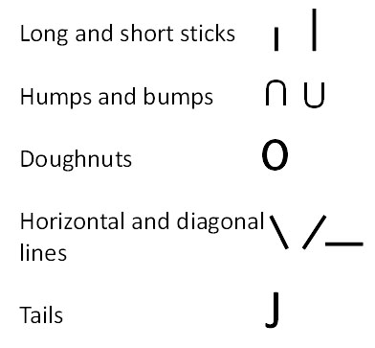
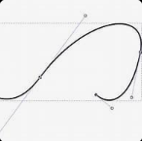
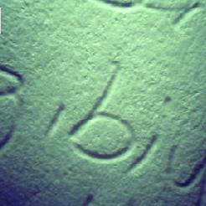
Microsoft’s trocr
Slant of handwriting
Curvature and Smoothness
Pressure distribution
Stroke patterns
Detects handwriting slant by finding edges and lines with OpenCV and calculates the average angle of detected lines.
Analyzes the direction of handwriting strokes by tracing contours and calculates angles between consecutive points of contours.
Calculates curvature for sets of three consecutive contour points using geometric formulas. Smoothness Is measured as the distance between points in a contour.
Measures handwriting pressure by applying Gaussian blur and thresholding on the grayscale image. Calculates the average sum of pixel intensities along rows.
Transformer-based Optical Character Recognition was developed to recognize text or images in scanned documents.

Slide 12
Curvature Classification
This was the feature that had results already closest to 0 and 1. The curvature column was ideal for binary classification. The numbers were either rounded down to 0 for left-handedness or up to 1 for right-handedness.

Slide 13
80/20 split ratio
Training set
Training Samples
Test samples
40 total, 20 left and 20 right
Whittled down from the handedness column and curvature classification.
Train_test_split is a scikit-learn function that splits dataset randomly based.
33 items
7 samples

Slide 14
Model architecture
Using np.random.seed(42) and tf.random.set_seed(42) ensures consistent results across runs. Reproducibility!
Conv2d extracts spatial features, MaxPooling2D reduces spatial dimensions to prevent overfitting, Flatten converts 2D to 1D, and Dense fully connects layers
Input shape 28, 28, 1. 28 pixel square and 1 indicates single channel which is grayscale
5 epochs for computational efficiency and prevents overfitting

Slide 15
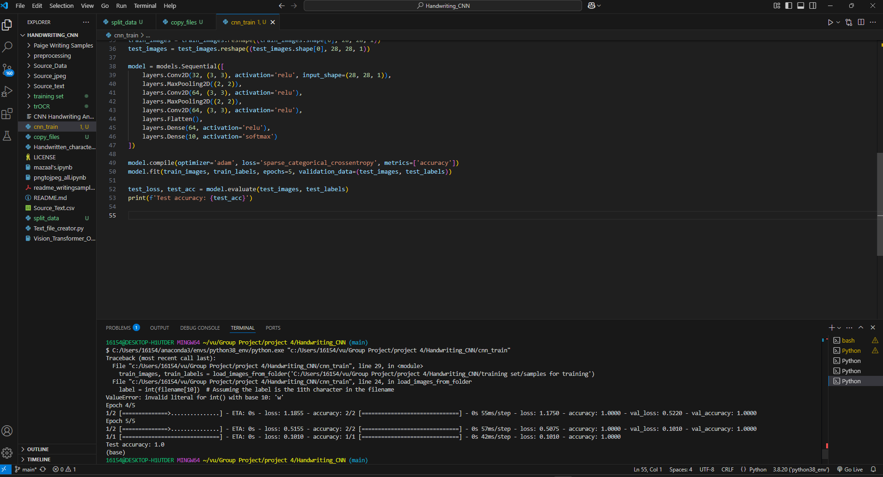
Result
100% accuracy

Slide 16
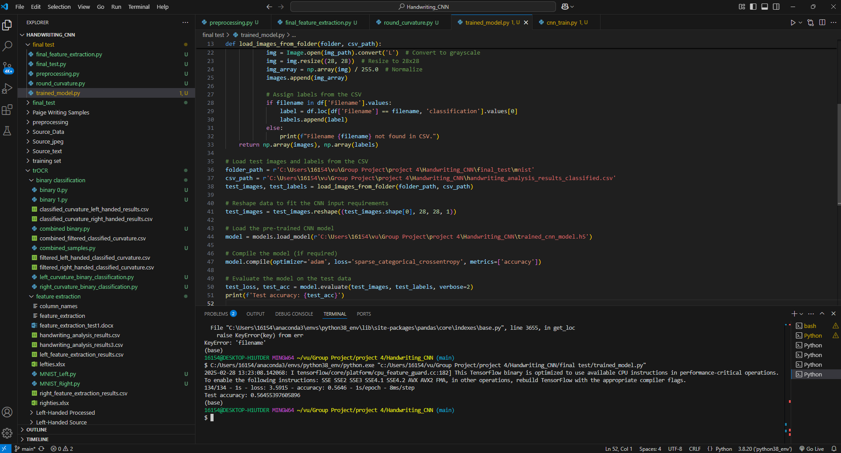

Slide 17


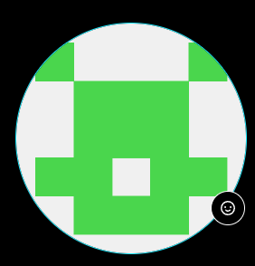




MEET OUR TEAM
Jordan graves
Jeff gary
Toni akande
Paige manguiat
​
​

Slide 18
THANK YOU ☺
Group 2
Jordan Graves, Jeff Gary, Toni Akande, Paige Manguiat
https://github.com/JGraves79/Handwriting_CNN.git
Vanderbilt University Data Analytics Bootcamp

